Slide 1



Hydrogen from plastics
Dr. Alvin Orbaek White
Associate Professor
Energy Safety Research Institute, Swansea University
Alvin.OrbaekWhite@Swansea.ac.uk
Founder
TrimTabs Ltd.
hello@trimtabs.ltd

Slide 2





Access to energy critical to life
Global population
generation
Population with electricity access*
transmission
Access to Energy - https://ourworldindata.org/energy-access
storage

Slide 3


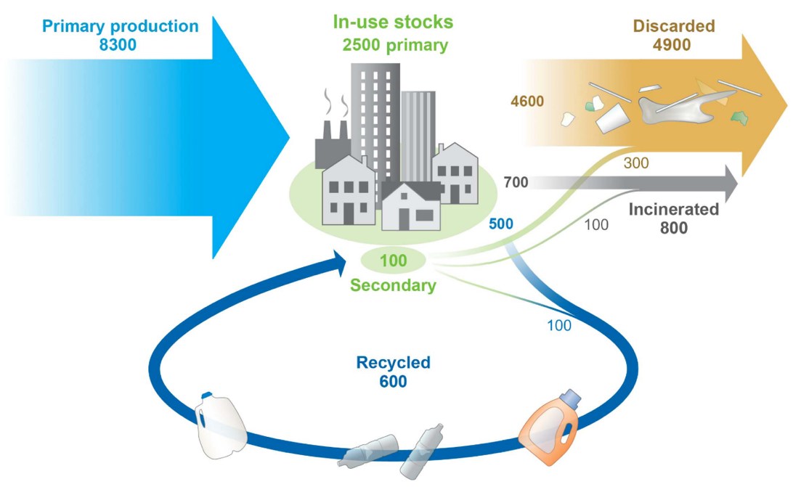
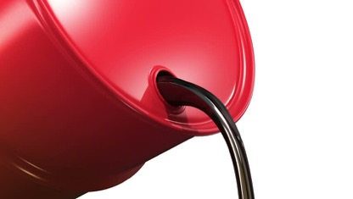

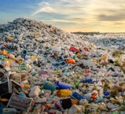
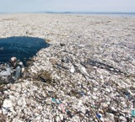
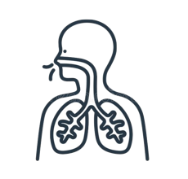
Global plastics
8,300 million metric tonnes
2 tonne per 3 ppl
FOSSIL FUELS
BECOME PLASTICS
60% discarded
Toxic gasses
Microplastics
Science Advances. 2017, 3, 7.

Slide 4


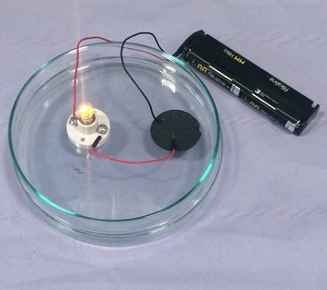
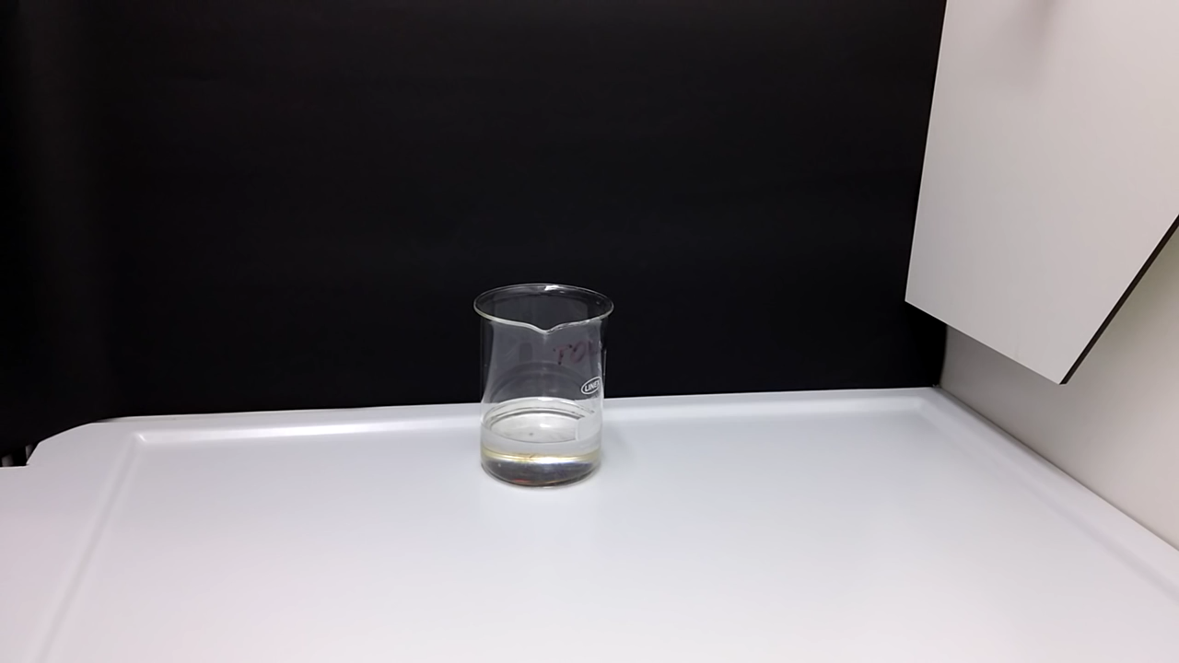
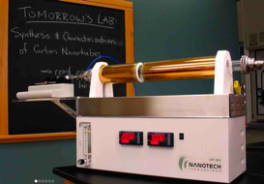
Chemical Recycling
1. Plastics/polymers are dissolved in appropriate solvents making polymer solvent combinations (PSCs)
2. PSCs are injected into chemical vapor deposition furnace
Forming solid carbon products
Mixed samples allows for multiple solvents and plastics
Liquid injection system allows for high throughput
Many carbon materials possible:
Graphene, carbon fibres, CNTs
1. Polymers 2022, 14, 112.
C. 2019, 5, 32
Nanomaterials 2022, 12, 9
Carbon Letters 2022, online
C. 2022, 8, 9
Chemosphere 2022, 295, 133889
https://www.youtube.com/watch?v=9hn2eybAOk4

Slide 5
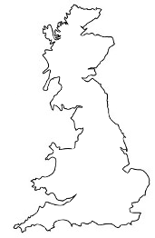
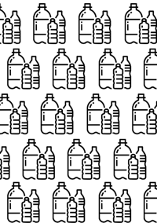
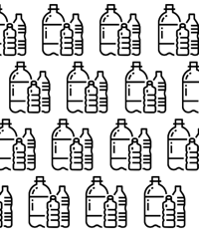
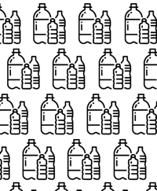

Hydrogen opportunity
Polystyrene
590 thousand tonne H₂/year
6.5 GW*
14 million tonne/year
Ostomy bags
169 thousand tonne H₂/year
1.9 GW*
Recycling Facts, see: https://www.recyclingbins.co.uk/recycling-facts/
(Accessed on 7 December, 2022)
Unpublished work funded by:
*90,000 Te of Hydrogen
= 1 GW of electrical power

Slide 6
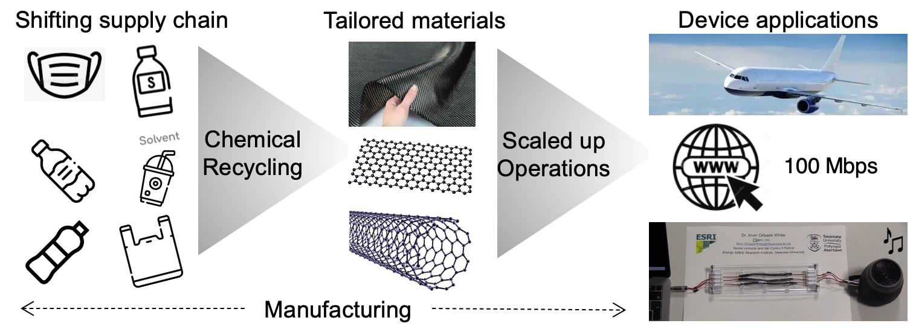
From the lab to the marketplace
U.S. Application No. 16/435,475
PCT patent application PCT/IB2019/054792
U.S. Application No.: 17/984,895
PCT patent application PCT/IB2020/061056

Slide 7
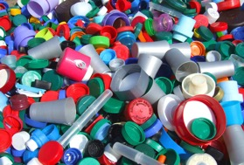
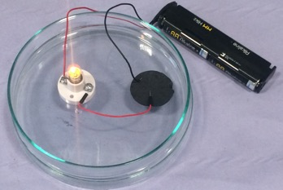
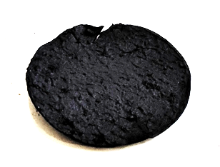

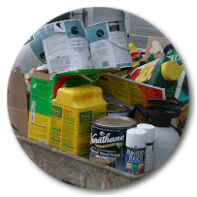
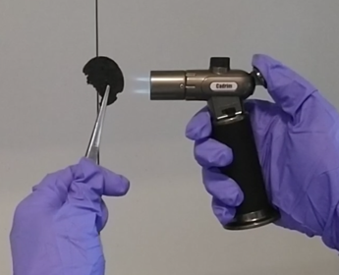
Overview
Solids
Value Materials
Hydrogen
Carbon nanotubes
Carbon nanofibers
Carbon fibres
Graphene
Face masks
Lycra
Elastene
Polyester
Polystyrene
Polyurethane
PVdC films
Hydrocolloids
Isotactic polypropylene
Polyethylene terephthalate
…. to name a few
Hydrogen
_{1 Te / 12 Te CNTs}
Carbon
100 Mbps
Liquids
toluene
benzene
M-cresol
cyclohexane
cyclopentane
methylcyclopentane
Hexafluoroisopropanol
… to name a few
Properties
Conductive
Lightweight
High strength
Non-flammable
Carbon sink

